Slide 1

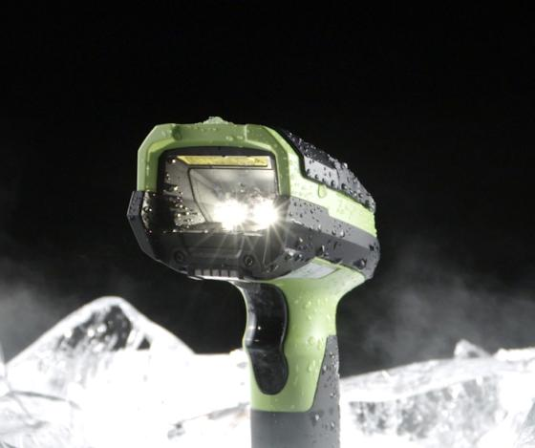
Zebra 3600 Series Ultra-Rugged Series
UNSTOPPABLE PERFORMANCE FOR THE TOUGHEST EXTREMES
PARTNER AND DISTRIBUTOR PRESENTATION
02/09/2018 © Zebra Technologies 2018

Slide 2
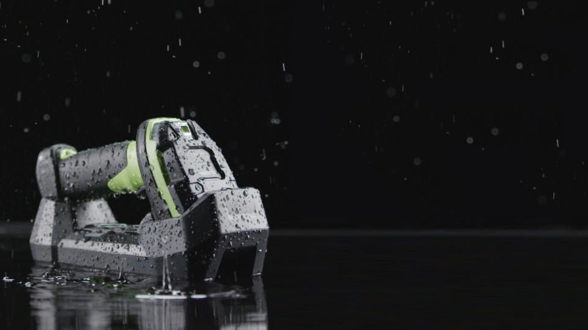
AGENDA
Introduction to the 3600 Series
3600 Series Features
Target Markets and Applications
Customer Engagement Questions and Handling Objections
Competitive Advantages
Upgrade Opportunities
Global Services
FAQs
Sales Tools and Resources

Slide 3
INTRODUCTION TO THE 3600 SERIES
3

Slide 4
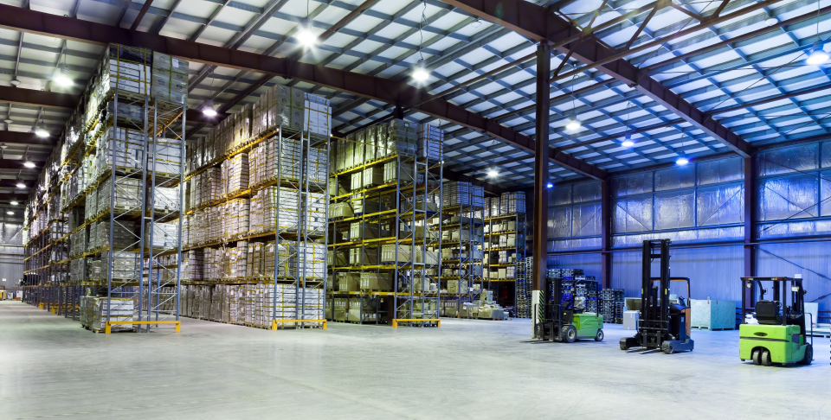
The Business Challenge
Industrial environments can be tough on the tech devices needed to perform routine but mission critical tasks
If a device can’t withstand multiple drops to a concrete floor, exposure to dirt, dust, grease, grime, and water without being compromised, productivity is lost.
If a device can’t read barcodes in a variety of lighting conditions, from a variety of distances, or read damaged/torn/smudged/shrink-wrapped barcodes, productivity is compromised.
4
Notes:
Businesses depend on the data embedded in barcodes to keep their lines running and processes flowing.
If a device isn’t purpose built to withstand multiple drops to a concrete floor, exposure to dirt, dust, grease and grime, and water without being compromised, productivity is lost. When your scanner can’t survive your use-cases, operator efficiency is negatively impacted and costs increase as a result

Slide 5
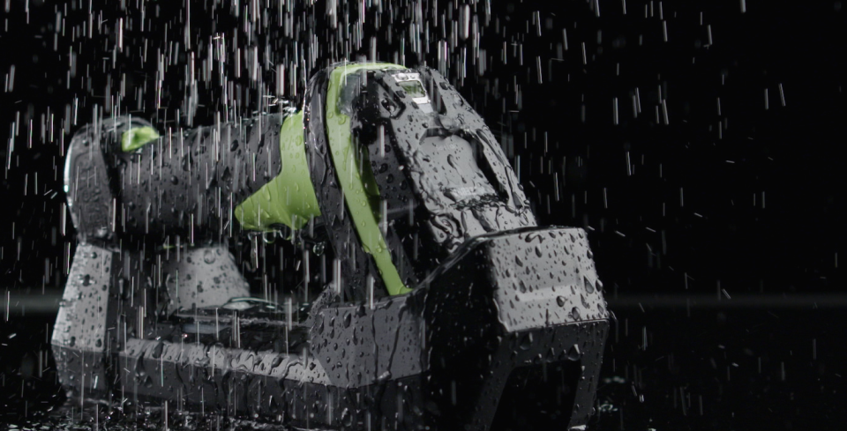
THE SOLUTION
A new class of handheld scanner built to deliver the unstoppable performance you need in your most demanding business environments.
The 3600 Series is purpose-built to…
…take more of a beating over a longer period of time
…scan faster and farther with greater accuracy and increased speed
…be deployed faster and managed more efficiently across an enterprise.
5

Slide 6
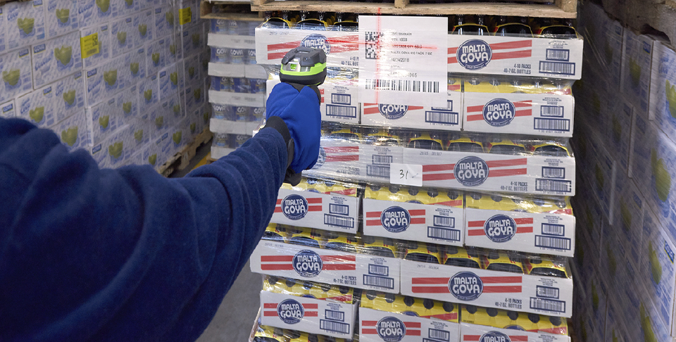
WHAT IS Unstoppable Performance?
Ultra-Rugged
Design
Superior
Performance
Zebra has completely redesigned our industrial line to provide UNSTOPPABLE PERFORMANCE in demanding industrial environments.
Unrivaled
Manageability
6

Slide 7

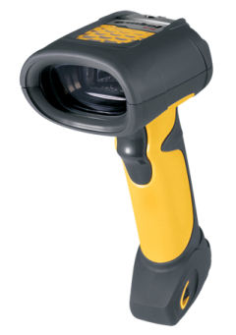
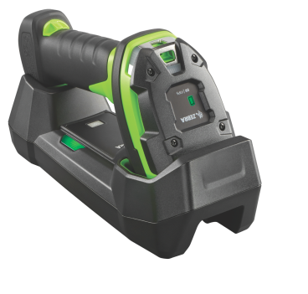

A Track Record of Success
A global leader in the barcode industry for over 35 years
1986
2006
2016
Introduced the industry’s first rugged handheld scanner back in 1986 – the LS8000 series
Launched the game-changing LS/DS 3500 Rugged Series in 2006: more than a million units sold
Created a new category of “ultra-rugged” scanners with the 3600 Series in 2016
7

Slide 8
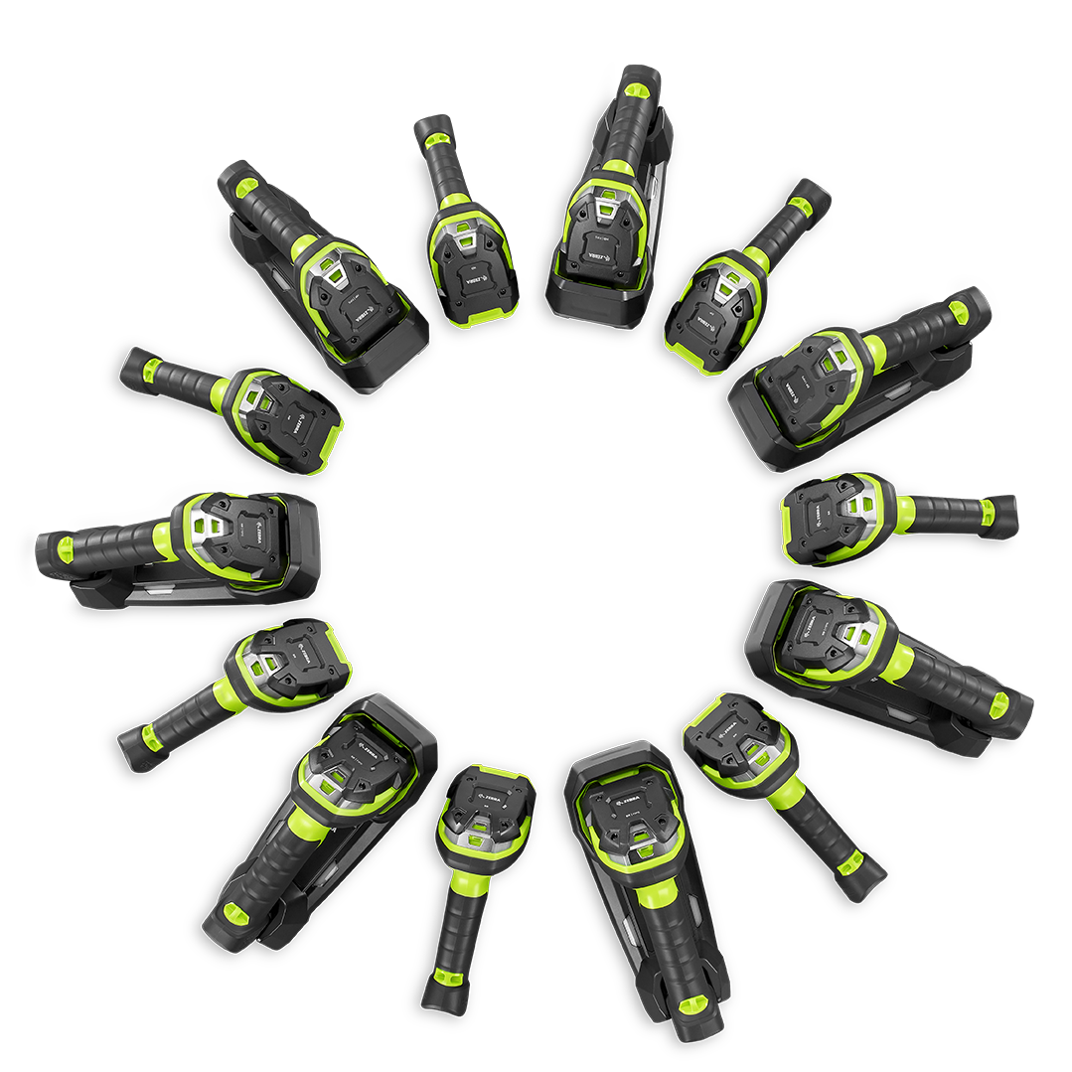
The Zebra 3600 Ultra-Rugged Scanner Series
A model to meet virtually every need in warehousing and manufacturing
LI3608-SR/LI3678-SR Standard range 1D barcode capture
LI3608-ER/LI3678-ER All-range 1D barcode capture
DS3608-SR/DS3678-SR Standard range scanning of 1D and 2D barcodes
DS3608-HP/DS3678-HP High performance scanner captures 1D/2D barcodes over longer distances, plus OCR, photos and documents
DS3608-HD/DS3678-HD Captures high-density 1D/2D barcodes
DS3608-DP/DS3678-DP Capture of Direct Part Marks (DPM)
DS3608-ER/DS3678-ER All-range 1D/2D barcode capture
8

Slide 9
Zebra 3600 Series Family
The following charts outline the key differences between each model.
 | LI3608-SR/ LI3678-SR | LI3608-ER/ LI3678-ER | DS3608-SR/ DS3678-SR | DS3608-HP/ DS3678-HP | DS3608-ER/ DS3678-ER | DS3608-HD/ DS3678-HD | DS3608-DP/ DS3678-DP
OVERVIEW AND TARGET APPLICATIONS
Overview | 1D Linear Standard Range | 1D Linear Extended Range | 1D/2D Standard Range | 1D/2D High Performance; Mid-Range | 1D/2D Long Range | 1D/2D High Density | 1D/2D Direct Part Marking
Target Applications | Near field 1D reading Shipping and receiving on loading docks and receiving dock doors Small item pick and pack Manufacturing WIP | Picking Forklift applications, Warehouse/ distribution, Transportationcross dock | Near field 1D/2D reading Shipping and receiving on loading docks and receiving dock doors Small item pick and pack Manufacturing WIP | Mid-Range reading for large items on loading docks for shipping and receiving Package/ courier services proof of delivery/image capture | Picking Forklift applications Warehouse/ distribution Transportation cross dock | Manufacturing:electronics, medical equipment, telecom | Lifetime Identification (UID) Track & Trace Maintenance management Warranty service Product authentication Automotive/ Aerospace/ Defense
9

Slide 10
Zebra 3600 Series Family (continued)
 | LI3608-SR/ LI3678-SR | LI3608-ER/ LI3678-ER | DS3608-SR/ DS3678-SR | DS3608-HP/ DS3678-HP | DS3608-ER/ DS3678-ER | DS3608-HD/ DS3678-HD | DS3608-DP/ DS3678-DP
DATA CAPTURE FEATURES
Read Range | Near contact to 3.5 ft./1 m | From 2 in./ 5.1 cm to 56 ft./17.1 m | Near contact to nearly 5 ft./1.5 m | Near contact to nearly 7 ft./2.1 m | From 3 in./ 7.6 cm to 70 ft./21.4 m | From 2.2 in./ 5.6 cm to 26 in./66 cm | From 1 in./2.5 cm to 5.8 in./14.7 cm
1D | ● | ● | ● | ● | ● | ● | ●
2D |  |  | ● | ● | ● | ● | ●
Basic Image Capture |  |  | ● | ● | ● | ● | ●
Advanced Image Capture |  |  |  | ●
DPM |  |  |  |  |  |  | ●
High Density Marks |  |  |  |  |  | ● | ●
10

Slide 11
Zebra 3600 Series Family (continued)
 | LI3608-SR/ LI3678-SR | LI3608-ER/ LI3678-ER | DS3608-SR/ DS3678-SR | DS3608-HP/ DS3678-HP | DS3608-ER/ DS3678-ER | DS3608-HD/ DS3678-HD | DS3608-DP/ DS3678-DP
DATA CAPTURE FEATURES (CONTINUED)
IUID |  |  | ● | ● | ● | ● | ●
OCR |  |  |  | ●
Digimarc |  |  | ● |  | ●
Signature Capture |  |  |  | ●
Multi-code Capture |  |  | ● | ● | ● | ● | ●
Picklist Selector | ● | ● | ● | ● | ● | ● | ●
ALL MODELS SHARE THE 3600 SERIES’ INDUSTRY-LEADING RUGGED SPECIFICATIONS, CORDLESS TECHNOLOGY, AND MANAGEABILITY FEATURES
11

Slide 12
3600 SERIES FEATURES
12

Slide 13
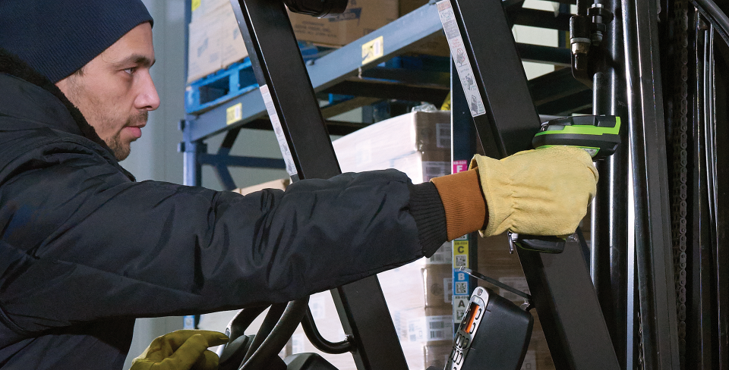
BEST-IN-CLASS SCANNING PERFORMANCE AND RANGE
Extraordinary Scanning Range: Over 30% more working range than the competition
* Exact figure varies by model
Capture Barcodes in Any Condition: Under shrinkwrap, dirty, damaged, poorly printed… capture it all the first time
Lightning-fast Time-to-decode: PRZM sets the bar for imaging, enhancing decode performance and snappiness
3 Feedback Modes: Vibration (haptic), green/red LEDs, and loud beep tone
13

Slide 14
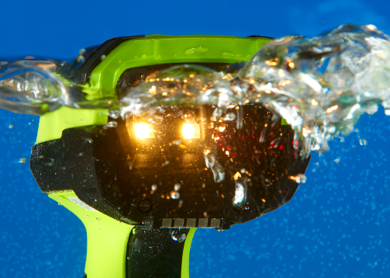
ULTRA-RUGGED: THE MOST INDESTRUCTIBLE DESIGN IN ITS CLASS
IP67 Rating: Dust-tight, spray proof and waterproof – can be submersed in water
Highest drop specification for any rugged scanner: 8 ft./2.4 m drops to concrete
Withstands 5,000 consecutive tumbles
Built for blazing heat and sub-zero temperatures
Industry’s only rugged “go anywhere” cradle with IP65 sealing
Industrial Strength For Your Most Challenging Environments

Slide 15
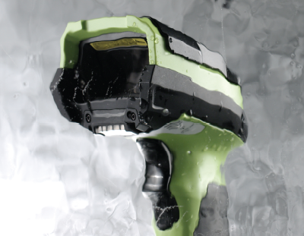
FREEZER READY
FOR YOUR COLDEST SUPPLY CHAINS
Corded Operating Temp.: -22ºF to 122ºF / -30ºC to 50ºC
Cordless Operating Temp.: -4ºF to 122ºF / -20ºC to 50ºC
Unique plastics, components and accessories can be used in freezing temperatures without becoming brittle
Ideal for refrigerated areas and freezers in food and pharmaceutical manufacturing, as well as outdoor storage yards in cold climates
* Heated scanner holder recommended to reduce condensation on the outside of scan window when moving in and out of freezers
15

Slide 16
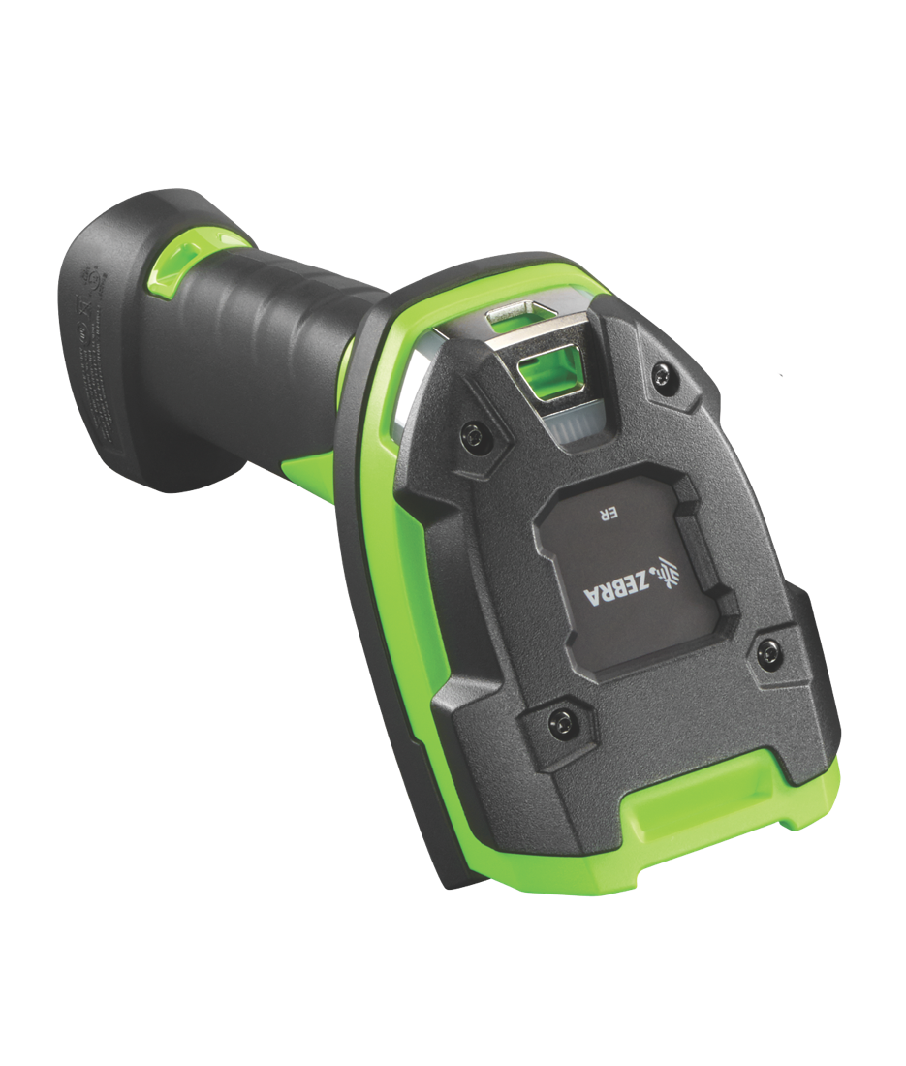
Ultra-rugged Design: In a Class of its Own
Speaker Output Bay and LED Light Pipes
Thick Rubber
Bumpers
Industrialized
Tether Hook
Legacy Grip- Enhancing Features
Scratch-Resistant Exit Window
Polycarbonate
Hard Hat
16
Notes:
Rubber bumpers: ultra-rugged form factor and thick rubber bumpers absorb the punishment of multiple drops to concrete from 8ft/2.4m
Speaker Output Bay & LED light pipes: tether hooks tend to wear through over time when attached to clips (e.g. tool balancer clip). The new reinforced hook on the 3600 series, designed to last for the life of the scanner, eliminates that problem.
Industrialized tether hook: tether hooks tend to wear through over time when attached to clips (e.g. tool balancer clip). The new reinforced hook on the 3600 series, designed to last for the life of the scanner, eliminates that problem.
Scratch resistant exit window: Polycarbonate window for increased impact strength and scratch resistance; helps maintain optical clarity in the toughest indoor and outdoor environments where abrasives such as dirt/sand/dust are prevalent.
Polycarbonate Hard Hat: New innovative design acts as a shock absorber to provide additional impact durability
Legacy Grip Enhancing Features: As always, the comfort of our end users comes first. In the case of the 3600 Series (corded and cordless) we designed and tested for a wide range of end-users hand sizes and an equally wide range of customer applications.

Slide 17
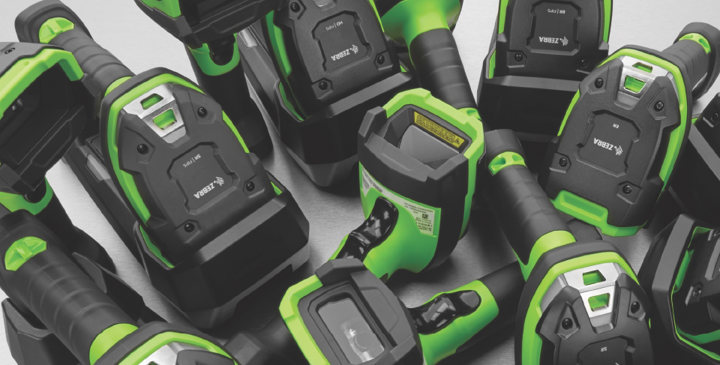
Unrivaled Manageability
Industry-best tools to simplify remote management and accelerate rollouts
Visionary Visibility into Detailed Battery Metrics
A wealth of battery metrics like battery age, health percentage, charge level and more
123Scan
Free patented software utility makes it easy to configure and deploy scanners across your enterprise
Scanner Management Service (SMS)
Free tool to remotely manage 3600 Series scanners and query asset information
Scanner Software Development Kit (SDK)
Easy application development (includes documentation, drivers, test utilities and sample source code)
17

Slide 18
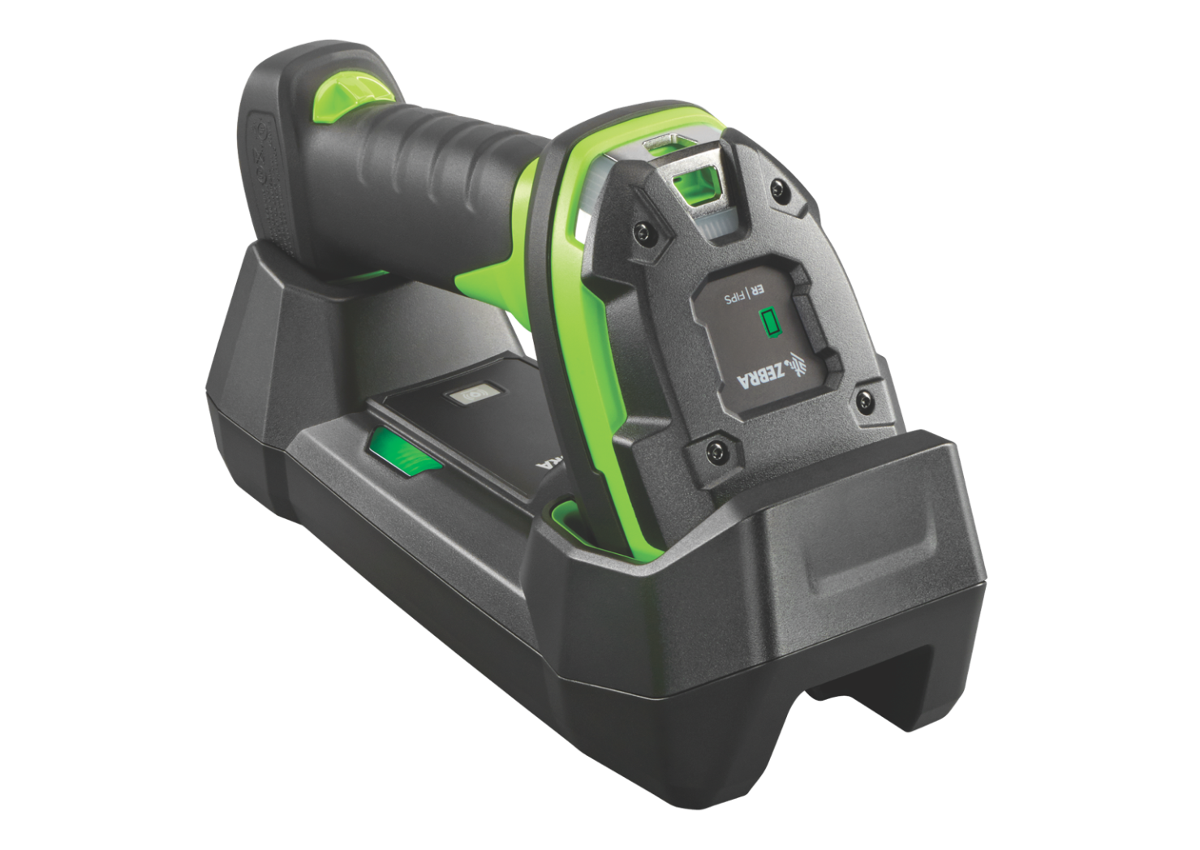





Set workers free with the industry’s
most superior cordless technology
Wi-Fi
Friendly
Mode
Standard
Bluetooth
4.0 with BLE
Battery
Charge Gauge
3,100 mAh Li-Ion Power Precision+ Battery
Battery Management Metrics
IP65 rated
cradle
18

Slide 19
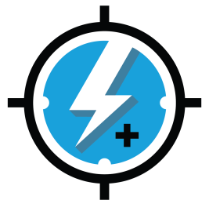
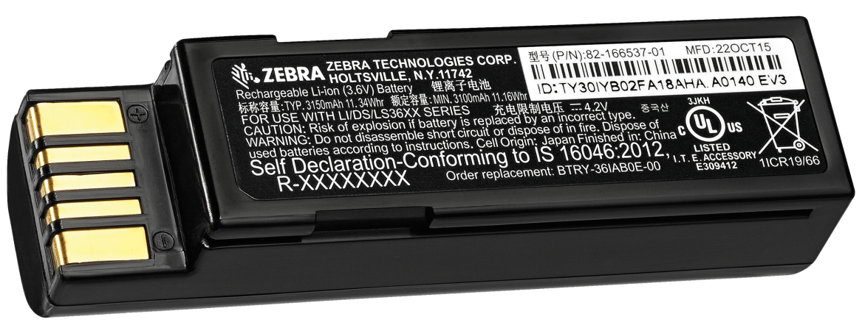
Power Precision+
Advanced Battery Technology
100,000+ scans per charge* — 3100 mAh battery is the most powerful in its class; delivers more than twice the scans per charge than competitive devices
Highly accurate charge gauge —
Calculates remaining power based on real-time available charge
Extensive battery metrics
— makes it easy to spot and retire aging batteries that can no longer hold a full charge
Complete solution —
Battery management software to easily view battery metrics
MINIMAL TIME SPENT MANAGING BATTERIES
MAXIMUM POWER FOR EVERY 3600 Scanner
* Most 3600 Series cordless scanners support 100,000+ scans per charge. LI3678-SR supports 140,000+ and DS3678-ER supports 70,000+ scans per charge.
19
19

Slide 20
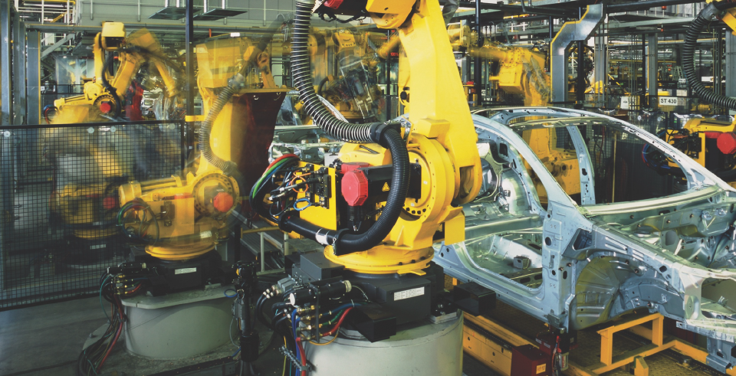
Network Connect for Automation
SEAMLESS CONNECTION BETWEEN THE 3600 SERIES AND YOUR INDUSTRIAL ETHERNET NETWORK
No need for third-party conversion equipment
Creates a more secure data environment
Reduces complexity
Eliminates a point of failure
Compatible with every 3600 Series scanner
20

Slide 21

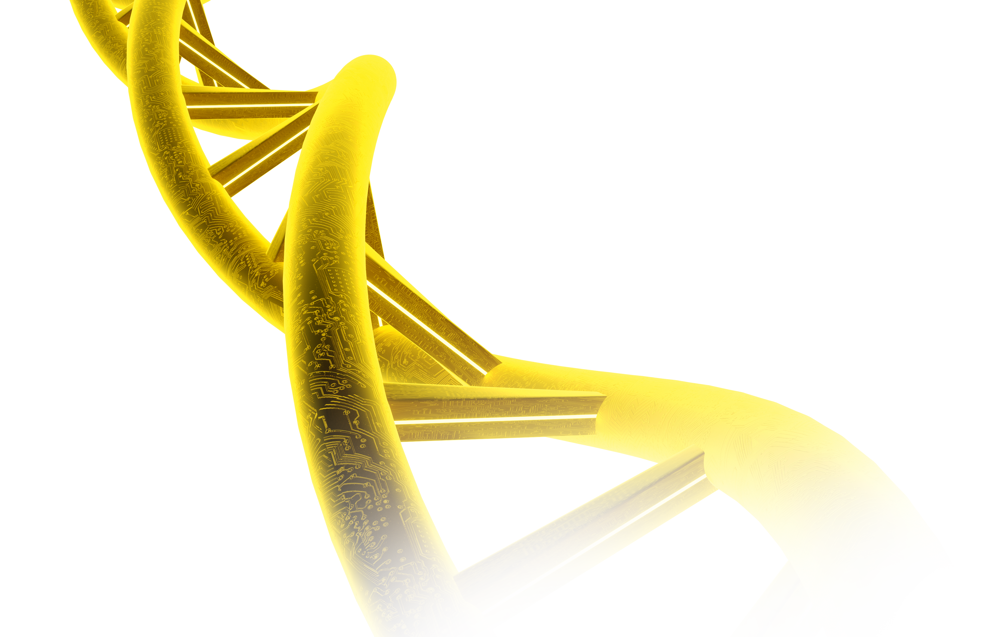

Introducing DATACAPTURE DNA. Because what’s inside your SCANNER matters.
What is DataCapture DNA?
The genetic code that simplifies the entire Zebra scanning experience. The result is innovation-driven performance that not only makes our data capture devices the best in the industry, but also the easiest.
21
Notes:
What is DataCapture DNA?
It’s a unique blend of highly intelligent firmware, software, utilities and apps.
It’s exclusive to Zebra and designed to resolve the needs of each and every stakeholder.
Plus, it’s compatible with Windows, iOS, Linux and Android.

Slide 22


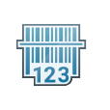











DataCapture DNA
applications on every 3600 Series Scanner
With DataCapture DNA, you get new features and capabilities that not only make Zebra data capture devices the best in the industry, but also the easiest.
PRODUCTIVITY TOOLS
MANAGEMENT TOOLS
VISIBILITY TOOLS
DEVELOPMENT TOOLS
Intelligent Document Capture
Multi-Code Data Formatting
Preferred Symbol
PRZM Intelligent Imaging
Wi-Fi Friendly Mode
123Scan
PowerPrecision+
Remote Management
Remote Diagnostics
ScanSpeed Analytics
Scanner Control Application
Scan-to-Connect
Software Development Kit (SDK)
Note: Available DNA tools vary by model. Refer to product Specification Sheets or Battlecards for model-specific information.
22

Slide 23
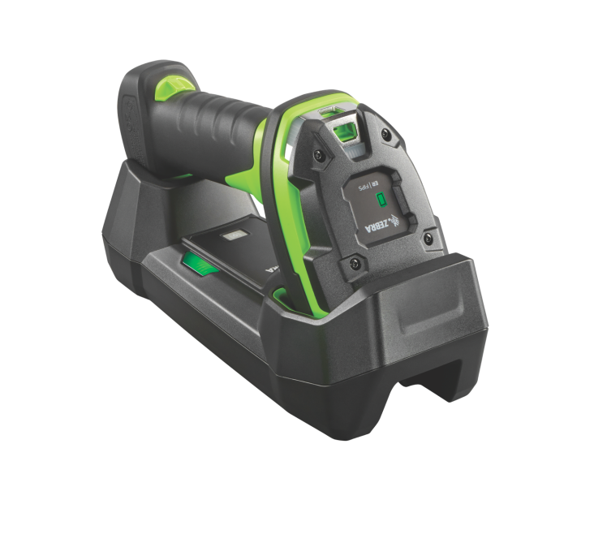
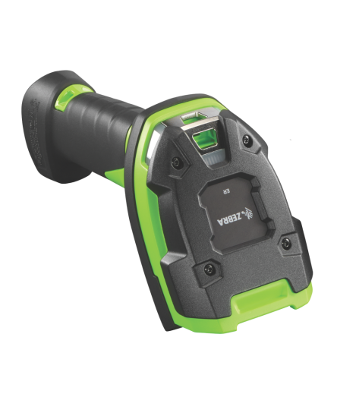
Key Takeaways
Scans at least 26% farther
23% more durable
Industry’s only
sealed cradle
Industry’s only waterproof scanner
100,000+ scans per charge
Industry’s
only on-board battery gauge
Only industrial line with PRZM Intelligent Imaging
Industry’s only battery management capability
THE ONLY INDUSTRIAL SCANNERS BUILT TO DELIVER
UNSTOPPABLE PERFORMANCE
Note: Specifications vary among 3600 Series models.
23

Slide 24
Target Markets and Applications
24

Slide 25

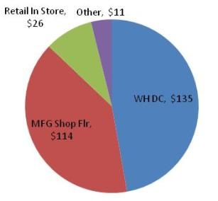
Deployment Environments
Target Applications
Pick/pack
Work in Progress
Shipping/ Receiving
Inventory Tracking
Track & Trace
Cross-docking
Deployment Environments
Warehousing/ Distribution
Cold Storage
Outdoor Yards
Manufacturing: Plant Floor and Warehousing
$285M
SAM
*Zebra Prod Mktg Intelligence Estimate 2015 Mkt SAM
25

Slide 26
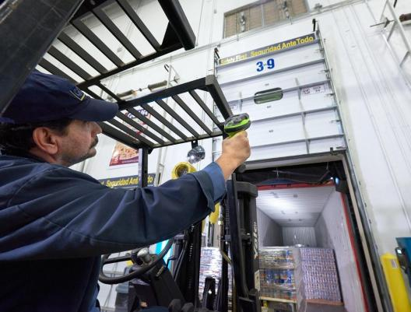
Vertical Markets: Warehousing
WAREHOUSING APPLICATIONS
Receiving and putaway
Inventory and materials management: cycle counting, replenishment
Picking
Shipping
Cross-docking
Reverse Logistics (processing of goods that are returned)
Yard Management
3600 SERIES MODELS
LI36x8-SR: Standard range 1D
LI36x8-ER: Extended range 1D
DS36x8-SR: Standard range 1D/2D
DS36x8-HP: 1D/2D, OCR, images, signatures, documents
DS36x8-ER: Extended range 1D/2D
26

Slide 27
Differentiating Features in Warehouse Opportunities
Feature | Why Your Customer Cares
Dustproof, sprayproof and waterproof | The 3600 Series is the only device in its class with a waterproof IP67 sealing rating, and the only scanner family to offer a second rating of IP65. It’s ready for virtually every challenging warehouse environment, from dusty aisles and outdoor yards to pouring rain out on the loading dock, spilled coffee and spray downs with a high-pressure hose.
Cradle with IP65 sealing | We sealed our Bluetooth cradle to IP65 to match the scanners, creating the only complete rugged cordless solution for your customer’s forklift and other material handling equipment drivers.
Built to handle drops to the concrete floor | Many device failures in the warehouse occur when the device is dropped on the concrete floor. That’s why all models in the 3600 Series offer a best-in-class 8 ft./2.4 m drop to concrete impact rating — 23 percent more durable than any other scanner in this class.
Scan nearer and farther with one device | With expanded working ranges in every model in the 3600 Series, workers can stay in one spot and capture more barcodes. All models offer 30 percent more working range than competitive devices.
Industry-leading extended range models | For workers that need maximum range, our extended range scanners can capture extra-wide barcodes just a hands-length away, as well as barcodes on the uppermost warehouse shelves up to 70 ft./21 m away (DS36x8-ER) or 56 ft./17.1 m away (LI36x8-ER).
First-time capture of imperfect barcodes | Barcodes that can’t be scanned instantly lower productivity levels. But even the most damaged barcodes are no match for our advanced scanning algorithms — whether barcodes are torn, dirty, smudged, poorly printed or under a layer of frost, workers can capture it all with one press of the scan trigger.
Multi-code feature | Many labels in the warehouse contain multiple bar codes — and with our Multi-code feature (available on DS3600 Series 2D imagers), workers can capture up to 20 barcodes in the time it takes to press the scan trigger.
27

Slide 28
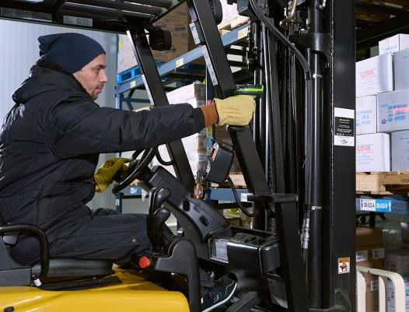
Vertical Markets: Cold Storage
COLD STORAGE APPLICATIONS
Receiving and putaway
Inventory and materials management: cycle counting, replenishment
Picking
Shipping
Cross-docking
Reverse Logistics (processing of goods that are returned)
Yard Management
3600 SERIES MODELS
LI36x8-SR: Standard range 1D
LI36x8-ER: Extended range 1D
DS36x8-SR: Standard range 1D/2D
DS36x8-HP: 1D/2D, OCR, images, signatures, documents
DS36x8-ER: Extended range 1D/2D
28

Slide 29
Differentiating Features in Cold Storage Opportunities
Feature | Why Your Customer Cares
Sub-zero temperature rating | We engineered the 3600 Series with an extreme working temperature range: -22º F to 122º F /-30º C to 50º C (corded) and -4º F to 122º F /-20º C to 50º C (cordless). Unique plastics, cables and components are designed to handle freezing temperatures without becoming brittle.
A battery that’s rated for the freezer | Battery performance often erodes as the temperature drops, but our unique PowerPrecision+ battery is rated for the freezer, with zero performance degradation at -4º F/-20º C. Your customers can give their workers the freedom of wireless in the freezer, without worrying about battery and reliability issues.
Heated scanner holder to avoid condensation | If workers frequently travel in and out of the freezer, the heated scanner holder keeps the scanner head warm to prevent the buildup of condensation on the scanner head. Performance is still unstoppable — in spite of constant temperature shocks.
Freezer-rated cables | Unlike many other rugged devices on the market, the 3600 Series offers cables with special jacketing to maintain flexibility in subzero temperatures, preventing costly cable failure and work interruptions.
Maximum scanning speed on every type of barcode | Whether workers are scanning 1D or 2D barcodes, they get an advanced scan engine optimized to provide maximum scanning speed. This boosts productivity, and ensures that workers aren’t spending more time than needed in the freezer, improving both their comfort and safety.
First-time capture of imperfect barcodes, including frosted barcodes | Cold storage is a tough place for a barcode label. And barcodes that can’t be scanned instantly lower productivity levels. But even the most damaged barcodes are no match for our advanced scanning algorithms — whether barcodes are torn, dirty, smudged, poorly printed or under a layer of frost, workers can capture it all with one press of the scan trigger.
Ergonomics for the freezer | The 3600 Series features an oversized scan trigger to make scanning easy even with the thickest gloves. A user-controllable, extra-loud beeper volume, combined with vibration feedback, ensures that workers instantly know a scan was successful — no matter how loud the environment might be.
29

Slide 30
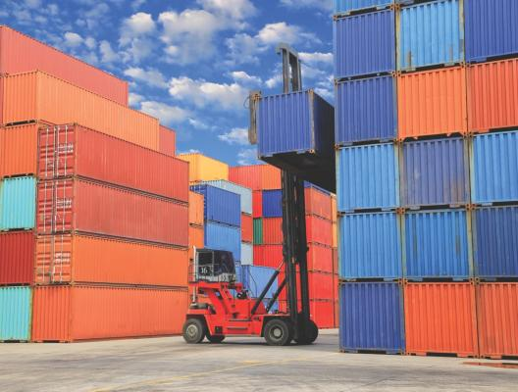
Vertical Markets: Outdoor Yards and Ports
WAREHOUSING APPLICATIONS
Receiving and putaway
Inventory and materials management: cycle counting, replenishment
Picking
Shipping
Cross-docking
Reverse Logistics (processing of goods that are returned)
Yard Management
3600 SERIES MODELS
LI36x8-SR: Standard range 1D
LI36x8-ER: Extended range 1D
DS36x8-SR: Standard range 1D/2D
DS36x8-HP: 1D/2D, OCR, images, signatures, documents
DS36x8-ER: Extended range 1D/2D
30

Slide 31
Differentiating Features in Outdoor Yard/Port Opportunities
Feature | Why Your Customer Cares
Dustproof, sprayproof and waterproof | The 3600 Series is the only device in its class with a waterproof IP67 sealing rating, and the only scanner family to offer a second rating of IP65. It’s ready for virtually every challenging outdoor environment, from puddles and mud to pouring rain, spilled coffee and spray downs with a high-pressure hose.
Cradle with IP65 sealing | We sealed our Bluetooth cradle to IP65 to match the scanners, creating the only complete rugged cordless solution for your customer’s forklift and other material handling equipment drivers.
Built to handle drops to the concrete floor | All models in the 3600 Series offer a best-in-class 8 ft./2.4 m drop to concrete impact rating — 23 percent more durable than any other scanner in this class.
Extreme temperature range | Scanners need to be able to handle life outdoors in all four seasons — the 3600 Series offers an extreme working temperature range: -22º F to 122º F /-30º C to 50º C (corded) and -4º F to 122º F /-20º C to 50º C (cordless).
Industry-leading extended range models | For workers that need maximum range, our extended range scanners can capture extra-wide barcodes just a hands-length away, as well as barcodes on the uppermost warehouse shelves up to 70 ft./21 m away (DS36x8-ER) or 56 ft./17.1 m away (LI36x8-ER).
First-time capture of imperfect barcodes, including frosted barcodes | Barcodes that can’t be scanned instantly lower productivity levels. But even the most damaged barcodes are no match for our advanced scanning algorithms — whether barcodes are torn, dirty, smudged, poorly printed or under a layer of frost, workers can capture it all with one press of the scan trigger.
Easy aiming, even in bright sunlight | Every model offers the superior aiming technology your workers need to capture any size barcode at any length, in any lighting condition, from the bright noon sun to the haze and fog that are common at seaports.
31

Slide 32
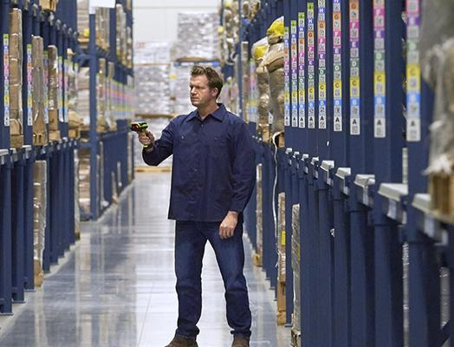
Vertical Markets: Manufacturing
MANUFACTURING APPLICATIONS
Traceability
Quality Assurance
Inventory and materials management: cycle counting, replenishment
Picking
Shipping
3600 SERIES MODELS
LI36x8-SR: Standard range 1D
DS36x8-SR: Standard range 1D/2D
DS36x8-HP: 1D/2D, OCR, images, signatures, documents
DS36x8-DP: 1D/2D, direct part marks for track and trace in industrial manufacturing
DS36x8-HD: 1D/2D, tiny dense codes that are common in electronics and medical equipment.
32

Slide 33
Differentiating Features in Manufacturing Opportunities
Feature | Why Your Customer Cares
Dustproof, sprayproof and waterproof | The 3600 Series is the only device in its class with a waterproof IP67 sealing rating, and the only scanner family to offer a second rating of IP65. It’s ready for virtually every challenging manufacturing plant environment, from dusty aisles and outdoor yards to pouring rain out on the loading dock, spilled coffee and spray downs with a high-pressure hose.
Cradle with IP65 sealing | We sealed our Bluetooth cradle to IP65 to match the scanners, creating the only complete rugged cordless solution for your customer’s forklift and other material handling equipment drivers.
Built to handle drops to the concrete floor | Many device failures in manufacturing occur when the device is dropped on the concrete floor. That’s why all models in the 3600 Series offer a best-in-class 8 ft./2.4 m drop to concrete impact rating — 23 percent more durable than any other scanner in this class.
Peak productivity for track and trace applications | The 3600 Series can capture literally every type of DPM code, regardless of size, surface, contrast or density — including dot peen, laser etch, ink mark, chemical etch, inkjet mold, cast and thermal spray. Advanced illumination technology provides the multiple lighting effects required to capture marks on any type of surface, even challenging marks such as low contrast codes on a black surface, marks on a very shiny surface or codes on corroded steel.
Capture 1D/2D and DPM with one device | If your customers need to capture direct part marks, our DPM model offers exceptional versatility, with the ability to capture 1D/2D bar codes, direct part marks and images in a single device. Instead of purchasing multiple scanners for specialized roles, they can deploy the same scanner to use on the production line for end-to-end track and trace of materials, for receiving applications in the warehouse and to track tools in the storeroom.
Bluetooth with Wi-Fi Friendly mode | Bluetooth devices can often create interference in Wi-Fi environments, disrupting workflows and impacting crucial data streams from nearby production line equipment. Now, your customers can just scan a single barcode to configure their cordless 3600 Bluetooth scanners with Zebra’s Wi-Fi Friendly mode, which completely eliminates any interference with their Wi-Fi infrastructure — guaranteed.
33

Slide 34
Customer Engagement Questions and Handling Objections
34

Slide 35
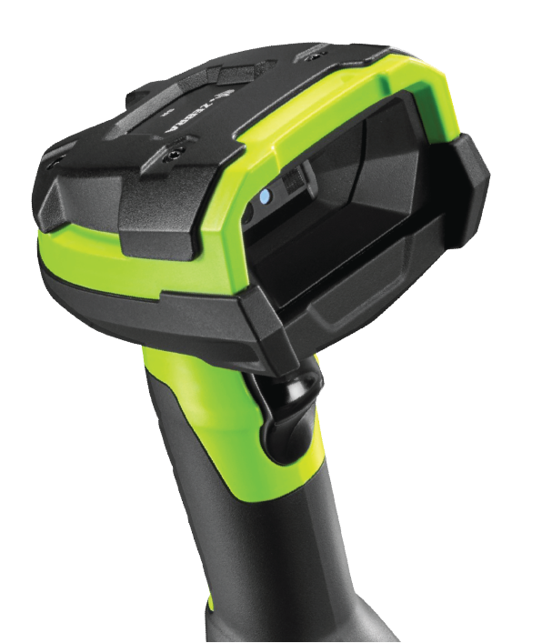
Customer Engagement Questions
Would you like to boost user productivity by deploying a new generation of scanners with unstoppable performance?
How do you currently deal with damaged or smudged barcodes in your environment? Do workers have trouble getting a positive scan on damaged, dirty or frosted labels?
Do you need to scan barcodes at close as well as long range? Do workers need to scan items/ shelf tags from a distance (i.e. on a high shelf or deep inside a truck)?
Do you have multiple types of devices deployed today in order to accommodate your scanning ranges, symbologies and indoor/outdoor environments?
Do you have labels with multiple barcodes? Would productivity increase if workers could capture up to 20 barcodes with the press of a trigger?
Have you experienced problems in the past with damage caused by a drop?
Do workers frequently move between the freezer and loading dock? Do you ever experience condensation issues or damage with your existing scanners? Recommend the heated scanner holder for use in freezers.

Slide 36
Customer Engagement Questions (contd.)
Would you like to give your workers cordless scanners but are concerned that Bluetooth will interfere with your Wi-Fi network and production line equipment?
Is your current cordless scanner battery pool hard to manage?
Do workers currently have a way to know the charge status of a cordless scanner?
Would you appreciate a battery with 50 percent more capacity?
Does your IT department have a way to know how healthy each and every one of your batteries is?
Can they spot and remove aging batteries before they impact worker productivity?
Do you have a way to remotely upgrade your scanners? How much time is spent staging, configuring, upgrading, managing and troubleshooting your current scanner pool?

Slide 37
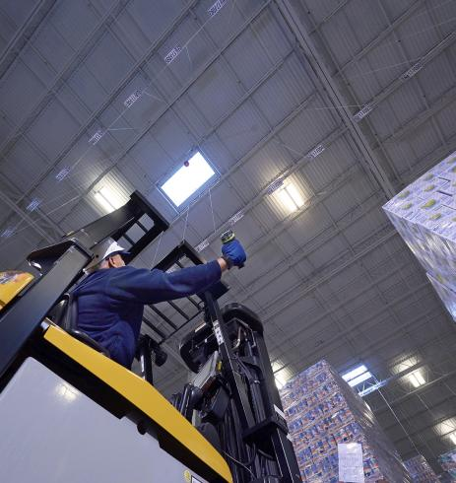
Objection Handlers: Why do I need an 8 ft./2.4 m drop spec?
Today’s warehouses often utilize all the vertical space they have. This means that the potential for longer drops is very real. Drops to concrete from a forklift or lift operator occur on a regular basis, often times while reaching high
overhead to scan a stacked pallet.
Scanners built to withstand drops from 8 ft./2.4 m will last longer than scanners built to withstand drops from 6.5 ft / 2m, yielding a lower TCO over the life of the scanner/fleet.
37
Notes:
Why do I need an 8’ drop spec?
Because a scanner built to withstand drops from 8 ft/2.4 m will last longer than a scanner built to withstand drops from 6.5 ft / 2m
Think your current “rugged” scanner is tough enough? It isn’t. Today’s warehouses maximize the use of their square footage; not just horizontally but vertically, leaving the potential for higher drops is very real. Drops to concrete from a forklift, lift operator or even from warehouse mezzanines occur on a regular basis, often times while reaching high overhead to scan a stacked pallet and often from heights higher than 6.5 ft/2m). The 3600 series were built from the ground up to not just withstand these punishing conditions, but to excel in them. The best part is that users will not have to pay a premium for it. Ultra-rugged durability at rugged pricing.

Slide 38
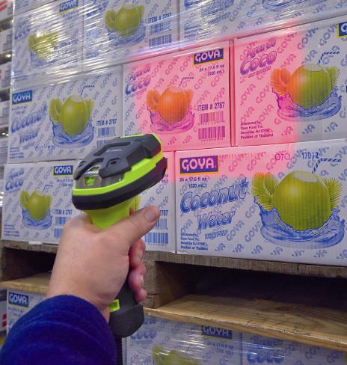
Objection Handlers: Why does battery capacity matter?
More battery capacity translates to more scans per shift, which means more up time and more worker productivity.
Our PowerPrecision+ batteries deliver at least twice as many scans per charge than the nearest competitive product… more than 50,000 more scans per charge. In addition, the on-board charge-gauge enables workers to quickly and easily determine battery charge.
38
Notes:
Our PowerPrecision+ batteries deliver at least twice as many scans oper charge than the nearest competitive product… more than 50,000 more scans per charge.
In addition, the on-board charge-gauge enables workers to quickly and easily determine battery charge. Think about how much time is wasted by having to swap out an uncharged scanner mid-shift - or worse; swapping out an uncharged scanner for another that may only be half-charged. The charge gauge alone on our models can virtually eliminate this type of work stoppage.

Slide 39
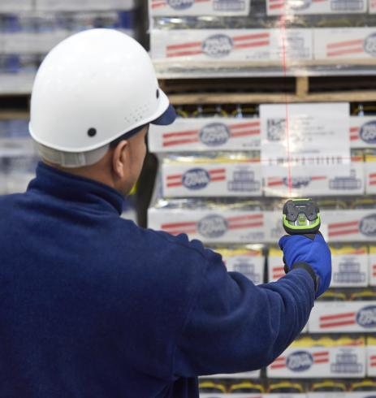
Objection Handlers: Why do I need 30% more working range?
30% more working range will increase workforce efficiency and help maximize productivity.
Each day your industrial scanners are used to capture hundreds, even thousands, of barcodes in locations both near and far to the operator. The ability to quickly capture barcode reads at any angle from across the aisle or from low pallet to high pallet without decode delays or having to pull the trigger twice can lead to significant operational efficiencies over a single shift. Aim, pull, capture, next.
39
Notes:
What is the benefit of 30% more working range?
30% more working range will increase workforce efficiency and help maximize productivity
Working range measures the scanner’s distance from a barcode and the time it takes to decode from that distance. The 3600 series delivers at least 30 percent more working range than competitive devices, capturing bar codes from a variety of distances as fast as workers can pull the trigger for extraordinary productivity.
Each and every day your industrial scanners are used to capture hundreds - even thousands - of barcodes in locations both near and far to the operator, and in various conditions throughout the warehouse. The ability to quickly capture barcode reads at any angle from across the aisle or from low pallet to high pallet without decode delays or having to pull the trigger twice can lead to significant operational efficiencies over a single shift. Aim, pull, capture, next.

Slide 40
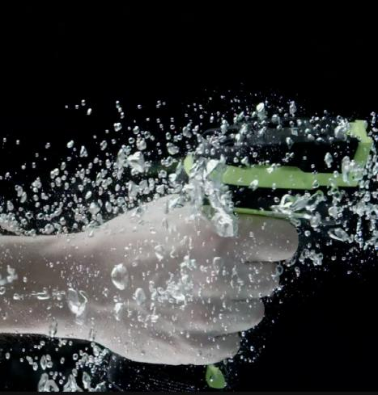
Objection Handlers: Why is IP67 important?
Because water and electrical components don’t mix, and sometimes water resistant just isn’t good enough for rugged environments. 3600 Series scanners are waterproof. You use the scanners outdoors in the snow and rain, spray them with jetting water or submerse them in water — the 3600 Series continues to perform at peak levels to keep your customer’s business moving. Zebra is the only manufacturer that can boast both an IP65 and IP67 sealing.
40
Notes:
Why is IP67 important?
Because water and electrical components don’t mix, and sometimes water resistant just isn’t good enough. 3600 series scanners are waterproof
The 3600 series scanner are built to be dustproof, sprayproof and waterproofed to IP67, meaning that they can operate in dirty, dusty environments, sprayed down with jetting water and even submersed in water for up to 30 minutes without performance being affected.
Drop a rugged scanner into a bucket of water and see what happens. It will sink and be ruined. The 3600 series scanners will FLOAT and can actually be submerged in up to 3 ft/1 m of water

Slide 41
Competitive Advantages
41

Slide 42
TOP ADVANTAGES FOR THE DS3608-SR/ DS3678-SR
UNMATCHED DEVICE PERFORMANCE
INDUSTRY-LEADING RUGGED DESIGN
EASIER FOR WORKERS TO USE
EASIER TO MANAGE
Unparalleled scanning performance
50% greater working range than other devices in its class
Only device to offer Bluetooth 4.0
Only device to offer Wi-Fi Friendly Mode
Double the scans per charge — 100,000+ scans per charge
Only device in its class to support Digimarc®
Only device to offer an 8 ft./2.4 m drop spec
Only device to offer a double sealing rating: IP65 and IP67
Only device with a rugged cradle
Only device with freezer compliant cables
Only device to offer single-board construction
Only device to offer a battery charge gauge
Only device to offer a Bluetooth status LED
Only device to offer three mix and match feedback modes: vibration, red/green LEDs, loud beep
Capture up to 20 barcodes — simultaneously
Detailed battery metrics for superior battery management
Industry-best free management tools
42
42

Slide 43
TOP ADVANTAGES FOR THE DS3608-ER/ DS3678-ER
UNMATCHED DEVICE PERFORMANCE
INDUSTRY-LEADING RUGGED DESIGN
EASIER FOR WORKERS TO USE
EASIER TO MANAGE
Reads 1D and 2D barcodes up to 50 percent closer and 35 percent farther than similar models in its class
Only near /far scanner in the market to read wide picklist codes up close
Only device to offer Bluetooth 4.0
Only device to offer Wi-Fi Friendly Mode
Over nine times the scans per charge — 70,000+ scans per charge
Only device in its class to support Digimarc®
Only device to offer an 8 ft./2.4 m drop spec
Only device to offer a double sealing rating: IP65 and IP67
Only device with a rugged cradle
Only device with freezer compliant cables
Only device to offer single-board construction
Only device to offer a battery charge gauge
Only device to offer a Bluetooth status LED
Only device to offer three mix and match feedback modes: vibration, red/green LEDs, loud beep
Capture up to 20 barcodes — simultaneously
Detailed battery metrics for superior battery management
Industry-best free management tools
43
43

Slide 44
TOP ADVANTAGES FOR THE DS3608-HP/ DS3678-HP
UNMATCHED DEVICE PERFORMANCE
INDUSTRY-LEADING RUGGED DESIGN
EASIER FOR WORKERS TO USE
EASIER TO MANAGE
Unparalleled scanning performance
Double the working range of competitive devices
Capture photos, documents and OCR
Only device to offer Bluetooth 4.0
Only device to offer Wi-Fi Friendly Mode
Over twice the scans per charge — 100,000+ scans per charge
Only device to offer an 8 ft./2.4 m drop spec
Only device to offer a double sealing rating: IP65 and IP67
Only device with a rugged cradle
Only device with freezer compliant cables
Only device to offer single-board construction
Only device to offer a battery charge gauge
Only device to offer a Bluetooth status LED
Only device to offer three mix and match feedback modes: vibration, red/green LEDs, loud beep
Capture up to 20 barcodes — simultaneously
Detailed battery metrics for superior battery management
Industry-best free management tools
44
44

Slide 45
TOP ADVANTAGES FOR THE DS3608-DP/ DS3678-DP
UNMATCHED DEVICE PERFORMANCE
INDUSTRY-LEADING RUGGED DESIGN
EASIER FOR WORKERS TO USE
EASIER TO MANAGE
Unparalleled scanning performance on 1D/2D
Comprehensive patented features to capture every kind of mark
Only device to offer an advanced illumination system for DPM
Only device to offer Bluetooth 4.0
Only device to offer Wi-Fi Friendly Mode
Over three times the scans per charge — 100,000+ scans per charge
Only device to offer an 8 ft./2.4 m drop spec
Only device to offer a double sealing rating: IP65 and IP67
Only device with a rugged cradle
Only device with freezer compliant cables
Only device to offer single-board construction
Only device to offer a battery charge gauge
Only device to offer a Bluetooth status LED
Only device to offer three mix and match feedback modes: vibration, red/green LEDs, loud beep
Capture up to 20 barcodes — simultaneously
Detailed battery metrics for superior battery management
Industry-best free management tools
45
45

Slide 46
TOP ADVANTAGES FOR THE DS3608-HD/ DS3678-HD
UNMATCHED DEVICE PERFORMANCE
INDUSTRY-LEADING RUGGED DESIGN
EASIER FOR WORKERS TO USE
EASIER TO MANAGE
Superior scanning on any high density 1D/2D barcode, including tiny and dense 3 mil codes
More than 40% greater range than other devices in its class
Only device to offer Bluetooth 4.0
Only device to offer Wi-Fi Friendly Mode
Over three times the scans per charge — 100,000+ scans per charge
Only device to offer an 8 ft./2.4 m drop spec
Only device to offer a double sealing rating: IP65 and IP67
Only device with a rugged cradle
Only device with freezer compliant cables
Only device to offer single-board construction
Only device to offer a battery charge gauge
Only device to offer a Bluetooth status LED
Only device to offer three mix and match feedback modes: vibration, red/green LEDs, loud beep
Capture up to 20 barcodes — simultaneously
Detailed battery metrics for superior battery management
Industry-best free management tools
46
46

Slide 47
TOP ADVANTAGES FOR THE LI3608-SR/ li3678-SR
UNMATCHED DEVICE PERFORMANCE
INDUSTRY-LEADING RUGGED DESIGN
EASIER FOR WORKERS TO USE
EASIER TO MANAGE
Unparalleled scanning performance on 1D
30% greater working range than other devices in its class
Only device to offer Bluetooth 4.0
Only device to offer Wi-Fi Friendly Mode
Nearly three times the scans per charge than competitive devices — 140,000+ scans per charge
Only device to offer an 8 ft./2.4 m drop spec
Only device to offer a double sealing rating: IP65 and IP67
Only device with a tumble spec
Only device with a rugged cradle
Only device with freezer compliant cables
Only device to offer single-board construction
Only device to offer a battery charge gauge
Only device to offer a Bluetooth status LED
Only device to offer three mix and match feedback modes: vibration, red/green LEDs, loud beep
Detailed battery metrics for superior battery management
Industry-best free management tools
47
47

Slide 48
TOP ADVANTAGES FOR THE LI3608-ER/ li3678-ER
UNMATCHED DEVICE PERFORMANCE
INDUSTRY-LEADING RUGGED DESIGN
EASIER FOR WORKERS TO USE
EASIER TO MANAGE
Reads 1D barcodes up to 40% closer and more than 270% farther than similar models in its class
Only near/far scanner in the market to read wide picklist codes up close
Only near/far scanner linear imager
Only device to offer Bluetooth 4.0
Only device to offer Wi-Fi Friendly Mode
More than twice the scans per charge than competitive devices — 100,000+ scans per charge
Only device to offer an 8 ft./2.4 m drop spec
Only device to offer a double sealing rating: IP65 and IP67
Only device with a rugged cradle
Only device with freezer compliant cables
Only device to offer single-board construction
Only device to offer a battery charge gauge
Only device to offer a Bluetooth status LED
Only device to offer three mix and match feedback modes: vibration, red/green LEDs, loud beep
Detailed battery metrics for superior battery management
Industry-best free management tools
48
48

Slide 49
Upgrade Opportunities
49

Slide 50
Upgrade Opportunity: DS36x8-SR
The following chart highlights why your customer should upgrade from the Zebra DS3508-SR or DS3578-SR.
 | DS3608-SR/DS3678-SR | DS3508-SR/DS3578-SR | Why Your Customer Cares
Rugged design
Drop Specification | 8.0 ft./2.4 m to concrete | 6.5 ft./2.0 m to concrete | More rugged: The 3600 Series’ 8 ft. drop spec sets a new industry standard; scan performance will not be compromised even after repeated 8 ft. drops to concrete.
Tumble Specification | 5,000 tumbles from 3.2 ft./1 m | No | Simulates the real-world tumbling that occurs with a drop. The ability to withstand 5,000 tumbles is a testament to the 3600 Series’ ultra-rugged durability.
Sealing: Scanner | IP65 and IP67 | IP65 | Dusty and dirty conditions are ubiquitous in an industrial environment, and outdoor use in rainy or freezing conditions are common. The 3600 Series is the first line of scanners to offer both IP65 and IP67 sealing.
Sealing: Base | IP65 | No | Cordless rugged scanners are only as good as the cradle they come with, and the 3600 Series features the industry’s only “go anywhere” rugged cradle with an IP65 rating.
Operating Temperature | Corded: -22º to 122º F/-30º to 50º C; Cordless: -4º F to 122º F/ -20º C to 50º C | Corded/Cordless: -4º F to 122º F/-20º C to 50º C | Corded version offers more extreme temperature rating down to -30ºC.
Freezer compliant cables | Yes | No | With the 3600 Series, the same scanner used in the warehouse can also be used in the freezer and other cold environments.
50

Slide 51
Upgrade Opportunity: DS36x8-SR (continued)
The following chart highlights why your customer should upgrade from the Zebra DS3508-SR or DS3578-SR.
 | DS3608-SR/DS3678-SR | DS3508-SR/DS3578-SR | Why Your Customer Cares
DATA CAPTURE FEATURES
Scan Engine | SE4710 | SE4500 | The SE4710 offers near contact performance like the DS35x8-SR, but also adds better far-field performance (for mid-range applications).
Simultaneous Multi-code Capture | Yes | No | Multicode 2.0: Best support for labels with multiple barcodes.
Digimarc | Yes | No | DS3608-SR/DS3678-SR scanners support Digimarc digital watermark technology. Digimarc creates efficiencies throughout the supply chain since workers no longer need to locate and position a visible barcode in the field of view.
CORDLESS FEATURES
Bluetooth | 4.0 | 2.1 | The DS3678-SR is the only device in its class to support Bluetooth 4.0 (Low Energy) for lightning fast communication and maximum energy efficiency.
Wi-Fi Friendly | Yes | No | Eliminates the wireless interference that Bluetooth devices can create in a Wi-Fi environment.
Battery Charge Gauge | Yes | No | First-in-its-class battery ‘charge gauge’ makes it easy for users to monitor remaining power.
PowerPrecision+ Battery | Yes: 3100 mAh | No: 2200 mAh | New 3100 mAh battery offers more capacity to last a full shift and longer. PowerPrecision+ offers a wealth of battery health-related data, including charge cycles consumed, current battery status and a State of Health meter.
51

Slide 52
Upgrade Opportunity: DS36x8-HP
The following chart highlights why your customer should upgrade from the Zebra DS3508-SR or DS3578-SR to the DS3608-HP/DS3678-HP.
 | DS3608-HP/DS3678-HP | DS3508-SR/DS3578-SR | Why Your Customer Cares
Rugged design
Drop Specification | 8.0 ft./2.4 m to concrete | 6.5 ft./2.0 m to concrete | More rugged: The 3600 Series’ 8 ft. drop spec sets a new industry standard; scan performance will not be compromised even after repeated 8 ft. drops to concrete.
Tumble Specification | 5,000 tumbles from 3.2 ft./1 m | No | Simulates the real-world tumbling that occurs with a drop. The ability to withstand 5,000 tumbles is a testament to the 3600 Series’ ultra-rugged durability.
Sealing: Scanner | IP65 and IP67 | IP65 | Dusty and dirty conditions are ubiquitous in an industrial environment, and outdoor use in rainy or freezing conditions are common. The 3600 Series is the first line of scanners to offer both IP65 and IP67 sealing.
Sealing: Base | IP65 | No | Cordless rugged scanners are only as good as the cradle they come with, and the 3600 Series features the industry’s only “go anywhere” rugged cradle with an IP65 rating.
Operating Temperature | Corded: -22º to 122º F/-30º to 50º C; Cordless: -4º F to 122º F/ -20º C to 50º C | Corded/Cordless: -4º F to 122º F/-20º C to 50º C | Corded version offers more extreme temperature rating down to -30ºC.
Freezer compliant cables | Yes | No | With the 3600 Series, the same scanner used in the warehouse can also be used in the freezer and other cold environments.
52

Slide 53
Upgrade Opportunity: DS36x8-HP (continued)
The following chart highlights why your customer should upgrade from the Zebra DS3508-SR or DS3578-SR.
 | DS3608-HP/DS3678-HP | DS3508-SR/DS3578-SR | Why Your Customer Cares
DATA CAPTURE FEATURES
Scan Engine | SE4750-MR | SE4500 | The DS36x8-HP offers a small near field dead zone, and a much improved far field scan zone. In fact, the DS36x8-HP is capable of scanning out to 7 ft./2.1 m away. And, the DS36x8-HP’s bright and crisp aimer makes scanning from farther away clear and easy.
OCR | Yes | No | Makes capturing optical characters found on legal documents, work orders or invoices quick and easy.
Image and Document Capture | Yes | No | Easily capture and transfer images for enhanced versatility.
Simultaneous Multi-code Capture | Yes | No | Multicode 2.0: Best support for labels with multiple barcodes.
CORDLESS FEATURES
Bluetooth | 4.0 | 2.1 | The DS3678-HP is the only device in its class to support Bluetooth 4.0 (Low Energy) for lightning fast communication and maximum energy efficiency.
Wi-Fi Friendly | Yes | No | Eliminates the wireless interference that Bluetooth devices can create in a Wi-Fi environment.
Battery Charge Gauge | Yes | No | First-in-its-class battery ‘charge gauge’ makes it easy for users to monitor remaining power.
PowerPrecision+ Battery | Yes: 3100 mAh | No: 2200 mAh | New 3100 mAh battery offers more capacity to last a full shift and longer. PowerPrecision+ offers a wealth of battery health-related data, including charge cycles consumed, current battery status and a State of Health meter.
53

Slide 54
Upgrade Opportunity: DS36x8-DP
The following chart highlights why your customer should upgrade from the Zebra DS3508-DP or DS3578-DP to the DS3608-DP/DS3678-DP.
 | DS3608-DP/DS3678-DP | DS3508-DP/DS3578-DP | Why Your Customer Cares
Rugged design
Drop Specification | 8.0 ft./2.4 m to concrete | 6.5 ft./2.0 m to concrete | More rugged: The 3600 Series’ 8 ft. drop spec sets a new industry standard; scan performance will not be compromised even after repeated 8 ft. drops to concrete.
Tumble Specification | 5,000 tumbles from 3.2 ft./1 m | No | Simulates the real-world tumbling that occurs with a drop. The ability to withstand 5,000 tumbles is a testament to the 3600 Series’ ultra-rugged durability.
Sealing: Scanner | IP65 and IP67 | IP65 | Dusty and dirty conditions are ubiquitous in an industrial environment, and outdoor use in rainy or freezing conditions are common. The 3600 Series is the first line of scanners to offer both IP65 and IP67 sealing.
Sealing: Base | IP65 | No | Cordless rugged scanners are only as good as the cradle they come with, and the 3600 Series features the industry’s only “go anywhere” rugged cradle with an IP65 rating.
Operating Temperature | Corded: -22º to 122º F/-30º to 50º C; Cordless: -4º F to 122º F/ -20º C to 50º C | Corded/Cordless: -4º F to 122º F/-20º C to 50º C | Corded version offers more extreme temperature rating down to -30ºC.
Freezer compliant cables | Yes | No | With the 3600 Series, the same scanner used in the warehouse can also be used in the freezer and other cold environments.
54

Slide 55
Upgrade Opportunity: DS36x8-DP (continued)
The following chart highlights why your customer should upgrade from the Zebra DS3508-DP or DS3578-DP.
 | DS3608-DP/DS3678-DP | DS3508-DP/DS3578-DP | Why Your Customer Cares
DATA CAPTURE FEATURES
Scan Engine | SE4750-DP | SE4500 | Purpose built illumination and focus to read DP code that are often high density, low contrast, on materials with rough or noisy backgrounds and materials that may be highly reflective.
CORDLESS FEATURES
Bluetooth | 4.0 | 2.1 | The DS3678-DP is the only device in its class to support Bluetooth 4.0 (Low Energy) for lightning fast communication and maximum energy efficiency.
Wi-Fi Friendly | Yes | No | Eliminates the wireless interference that Bluetooth devices can create in a Wi-Fi environment.
Battery Charge Gauge | Yes | No | First-in-its-class battery ‘charge gauge’ makes it easy for users to monitor remaining power.
PowerPrecision+ Battery | Yes: 3100 mAh | No: 2200 mAh | New 3100 mAh battery offers more capacity to last a full shift and longer. PowerPrecision+ offers a wealth of battery health-related data, including charge cycles consumed, current battery status and a State of Health meter.
55

Slide 56
Upgrade Opportunity: DS36x8-HD
The following chart highlights why your customer should upgrade from the Zebra DS3508-HD or DS3578-HD to the DS3608-HD/DS3678-HD.
 | DS3608-HD/DS3678-HD | DS3508-HD/DS3578-HD | Why Your Customer Cares
Rugged design
Drop Specification | 8.0 ft./2.4 m to concrete | 6.5 ft./2.0 m to concrete | More rugged: The 3600 Series’ 8 ft. drop spec sets a new industry standard; scan performance will not be compromised even after repeated 8 ft. drops to concrete.
Tumble Specification | 5,000 tumbles from 3.2 ft./1 m | No | Simulates the real-world tumbling that occurs with a drop. The ability to withstand 5,000 tumbles is a testament to the 3600 Series’ ultra-rugged durability.
Sealing: Scanner | IP65 and IP67 | IP65 | Dusty and dirty conditions are ubiquitous in an industrial environment, and outdoor use in rainy or freezing conditions are common. The 3600 Series is the first line of scanners to offer both IP65 and IP67 sealing.
Sealing: Base | IP65 | No | Cordless rugged scanners are only as good as the cradle they come with, and the 3600 Series features the industry’s only “go anywhere” rugged cradle with an IP65 rating.
Operating Temperature | Corded: -22º to 122º F/-30º to 50º C; Cordless: -4º F to 122º F/ -20º C to 50º C | Corded/Cordless: -4º F to 122º F/-20º C to 50º C | Corded version offers more extreme temperature rating down to -30ºC.
Freezer compliant cables | Yes | No | With the 3600 Series, the same scanner used in the warehouse can also be used in the freezer and other cold environments.
56

Slide 57
Upgrade Opportunity: DS36x8-HD (continued)
The following chart highlights why your customer should upgrade from the Zebra DS3508-SR or DS3578-SR.
 | DS3608-HD/DS3678-HD | DS3508-HD/DS3578-HD | Why Your Customer Cares
DATA CAPTURE FEATURES
Scan Engine | SE4750 | SE4500 | Custom focus to achieve barcode reading down to 3 mil with little to no sacrifice on reading lower density codes.
Simultaneous Multi-code Capture | Yes | No | Multicode 2.0: Best support for labels with multiple barcodes.
CORDLESS FEATURES
Bluetooth | 4.0 | 2.1 | The DS3678-HD is the only device in its class to support Bluetooth 4.0 (Low Energy) for lightning fast communication and maximum energy efficiency.
Wi-Fi Friendly | Yes | No | Eliminates the wireless interference that Bluetooth devices can create in a Wi-Fi environment.
Battery Charge Gauge | Yes | No | First-in-its-class battery ‘charge gauge’ makes it easy for users to monitor remaining power.
PowerPrecision+ Battery | Yes: 3100 mAh | No: 2200 mAh | New 3100 mAh battery offers more capacity to last a full shift and longer. PowerPrecision+ offers a wealth of battery health-related data, including charge cycles consumed, current battery status and a State of Health meter.
57

Slide 58
Upgrade Opportunity: DS36x8-ER
The following chart highlights why your customer should upgrade from the Zebra DS3508-ER or DS3578-ER to the DS3608-ER/DS3678-ER.
 | DS3608-HD/DS3678-HD | DS3508-HD/DS3578-HD | Why Your Customer Cares
Rugged design
Drop Specification | 8.0 ft./2.4 m to concrete | 6.5 ft./2.0 m to concrete | More rugged: The 3600 Series’ 8 ft. drop spec sets a new industry standard; scan performance will not be compromised even after repeated 8 ft. drops to concrete.
Tumble Specification | 5,000 tumbles from 3.2 ft./1 m | No | Simulates the real-world tumbling that occurs with a drop. The ability to withstand 5,000 tumbles is a testament to the 3600 Series’ ultra-rugged durability.
Sealing: Scanner | IP65 and IP67 | IP65 | Dusty and dirty conditions are ubiquitous in an industrial environment, and outdoor use in rainy or freezing conditions are common. The 3600 Series is the first line of scanners to offer both IP65 and IP67 sealing.
Sealing: Base | IP65 | No | Cordless rugged scanners are only as good as the cradle they come with, and the 3600 Series features the industry’s only “go anywhere” rugged cradle with an IP65 rating.
Operating Temperature | Corded: -22º to 122º F/-30º to 50º C; Cordless: -4º F to 122º F/ -20º C to 50º C | Corded/Cordless: -4º F to 122º F/-20º C to 50º C | Corded version offers more extreme temperature rating down to -30ºC.
Freezer compliant cables | Yes | No | With the 3600 Series, the same scanner used in the warehouse can also be used in the freezer and other cold environments.
58

Slide 59
Upgrade Opportunity: DS36x8-ER (continued)
The following chart highlights why your customer should upgrade from the Zebra DS3508-ER or DS3578-ER.
 | DS3608-ER/DS3678-ER | DS3508-ER/DS3578-ER | Why Your Customer Cares
DATA CAPTURE FEATURES
Read Range | From 3 in./7.6 cm to 70 ft./21.4 m | From near contact to 30 ft./9.14 m away | The range of the DS36x8-ER is 57% greater than the DS35x8-ER imager, enabling workers to reach more pallets and warehouse shelves faster, without having to move closer.
Near Read Range for Wide Barcodes (4.0 in./10.2 cm) | 7 in./17.8 cm |  | The DS36x8-ER is the only near /far scanner on the market to read wide picklist codes up close. You can offer your customers one scanner that can easily read barcodes on the uppermost shelves of warehouse racks, as well as extra-wide codes just a hands-length away.
Simultaneous Multi-code Capture | Yes | No | Multicode 2.0: Best support for labels with multiple barcodes.
CORDLESS FEATURES
Bluetooth | 4.0 | 2.1 | The DS3678-ER is the only device in its class to support Bluetooth 4.0 (Low Energy) for lightning fast communication and maximum energy efficiency.
Wi-Fi Friendly | Yes | No | Eliminates the wireless interference that Bluetooth devices can create in a Wi-Fi environment.
Battery Charge Gauge | Yes | No | First-in-its-class battery ‘charge gauge’ makes it easy for users to monitor remaining power.
PowerPrecision+ Battery | Yes: 3100 mAh | No: 2200 mAh | New 3100 mAh battery offers more capacity to last a full shift and longer. PowerPrecision+ offers a wealth of battery health-related data, including charge cycles consumed, current battery status and a State of Health meter.
59

Slide 60
Upgrade Opportunity: LI36x8-ER
The following chart highlights why your customer should upgrade from the Zebra laser LS4308-ER or LS3578-ER to the LI36x8-ER.
 | LI3608-ER/LI3678-ER |  | LS3408-ER (corded) | LS3578-ER (cordless) | Why Your Customer Cares
Rugged design
Drop Specification |  | 8.0 ft./2.4 m to concrete | 6.5 ft./2.0 m to concrete | 6.5 ft./2.0 m to concrete | More rugged: The 3600 Series’ 8 ft. drop spec sets a new industry standard; scan performance will not be compromised even after repeated 8 ft. drops to concrete.
Tumble Specification |  | 5,000 tumbles from 3.2 ft./1 m | No | 2,500 tumbles from 3.2 ft./1 m | Simulates the real-world tumbling that occurs with a drop. The ability to withstand 5,000 tumbles is a testament to the 3600 Series’ ultra-rugged durability.
Sealing: Scanner |  | IP65 and IP67 | IP65 | IP65 | Dusty and dirty conditions are ubiquitous in an industrial environment, and outdoor use in rainy or freezing conditions are common. The 3600 Series is the first line of scanners to offer both IP65 and IP67 sealing.
Sealing: Base |  | IP65 | N/A | No | Cordless rugged scanners are only as good as the cradle they come with, and the 3600 Series features the industry’s only “go anywhere” rugged cradle with an IP65 rating.
Freezer compliant cables |  | Yes | No |  | With the 3600 Series, the same scanner used in the warehouse can also be used in the freezer and other cold environments.
60

Slide 61
Upgrade Opportunity: LI36x8-ER (continued)
The following chart highlights why your customer should upgrade from the Zebra laser LS4308-ER or LS3578-ER to the LI36x8-ER.
 | LI3608-ER/LI3678-ER | LS3408-ER (corded) | LS3578-ER (cordless) | Why Your Customer Cares
DATA CAPTURE FEATURES
Read Range | From 2 in./5.1 cm to 56 ft./17.1 m | From .25 in./.64 cm to 45 ft./13.7 m | From .25 in./.64 cm to 45 ft./13.7 m | The LI36x8-ER can read 1D barcodes 24% farther than previous generation laser models, enabling workers to reach more pallets and warehouse shelves faster, without having to move closer.
Near Read Range for Wide Barcodes (4.0 in./10.2 cm) | 6 in./15.2 cm | 16. in./40.6 cm | 16. in./40.6 cm | The LI36x8-ER is the only near /far scanner in its class to read wide picklist codes up close. You can offer your customers one scanner that can easily read barcodes on the uppermost shelves of warehouse racks, as well as extra-wide codes just a hands-length away.
CORDLESS FEATURES
Bluetooth | 4.0 | N/A | 1.2 | The LI3678-ER is the only device in its class to support Bluetooth 4.0 (Low Energy) for lightning fast communication and maximum energy efficiency.
Wi-Fi Friendly | Yes | N/A | No | Eliminates the wireless interference that Bluetooth devices can create in a Wi-Fi environment.
Battery Charge Gauge | Yes | N/A | No | First-in-its-class battery ‘charge gauge’ makes it easy for users to monitor remaining power.
Power Precision+ Battery | Yes: 3100 mAh | N/A | No: 2200 mAh | New 3100 mAh battery offers more capacity to last a full shift and longer. PowerPrecision+ offers a wealth of battery health-related data, including charge cycles consumed, current battery status and a State of Health meter.
61

Slide 62
Upgrade Opportunity: LI36x8-SR
The following chart highlights why your customer should upgrade from the Zebra laser LS4308-FZ or LS3578-FZ to the LI36x8-SR.
 | LI3608-SR/LI3678-SR | LS4308-FZ/LS3578-FZ | Why Your Customer Cares
Rugged design
Drop Specification | 8.0 ft./2.4 m to concrete | 6.5 ft./2.0 m to concrete | More rugged: The 3600 Series’ 8 ft. drop spec sets a new industry standard; scan performance will not be compromised even after repeated 8 ft. drops to concrete.
Tumble Specification | 5,000 tumbles from 3.2 ft./1 m | 2,500 tumbles from 3.2 ft./1 m | Simulates the real-world tumbling that occurs with a drop. The ability to withstand 5,000 tumbles is a testament to the 3600 Series’ ultra-rugged durability.
Sealing: Scanner | IP65 and IP67 | IP65 | Dusty and dirty conditions are ubiquitous in an industrial environment, and outdoor use in rainy or freezing conditions are common. The 3600 Series is the first line of scanners to offer both IP65 and IP67 sealing.
Sealing: Base | IP65 | No | Cordless rugged scanners are only as good as the cradle they come with, and the 3600 Series features the industry’s only “go anywhere” rugged cradle with an IP65 rating.
62

Slide 63
Upgrade Opportunity: LI36x8-SR (continued)
The following chart highlights why your customer should upgrade from the Zebra laser LS4308-FZ or LS3578-FZ to the LI36x8-SR.
 | LI3608-SR/LI3678-SR | LS4308-FZ/LS3578-FZ | Why Your Customer Cares
DATA CAPTURE FEATURES
Scan Performance | Time to Decode - best Reads bad codes - best Read Range - best | Time to Decode - good Reads bad codes - good Read Range - good | The LI36x8-SR offers superior scan performance, with lightning fast capture of 1D barcodes in virtually any condition at longer ranges. In addition, the LI36x8-SR offers better scan performance when reading through plastic wrap that is common in warehouse applications.
Capable of reading barcodes off LCD screens | Yes | No | Increases application versatility: workers can scan 1D barcodes off computer screens and mobile devices.
Read range: 5 mil Code 39 | 3.3 in. to 14.5 in. | 2.5 in. to 7.25 in. | With the exception of near-field scanning of 5 mil barcodes, the LI36x8-SR offers better scanning range on both near-field and far-field data capture on a wide range of barcode sizes.
Read range at 7.5 mil Code 39 | 0 to 21.5 in. | 2 to 15.75 in.
Read range at 20 mil Code 39 | 0 to 41.5 in. | 0 to 39.5 in.
Read range at 13 mil UPC-A | 0 to 26.5 in. | 1 to 24 in.
63

Slide 64
Upgrade Opportunity: LI36x8-SR (continued)
The following chart highlights why your customer should upgrade from the Zebra laser LS4308-FZ or LS3578-FZ to the LI36x8-SR.
 | LI3608-SR/LI3678-SR | LS4308-FZ/LS3578-FZ | Why Your Customer Cares
CORDLESS FEATURES
Bluetooth | 4.0 | 2.1 | The LI3678-SR is the only device in its class to support Bluetooth 4.0 (Low Energy) for lightning fast communication and maximum energy efficiency.
Wi-Fi Friendly | Yes | No | Eliminates the wireless interference that Bluetooth devices can create in a Wi-Fi environment.
Battery Charge Gauge | Yes | No | First-in-its-class battery ‘charge gauge’ makes it easy for users to monitor remaining power.
Power Precision+ Battery | Yes: 3100 mAh | No: 2200 mAh | New 3100 mAh battery offers more capacity to last a full shift and longer. PowerPrecision+ offers a wealth of battery health-related data, including charge cycles consumed, current battery status and a State of Health meter.
64

Slide 65
Global Services
65

Slide 66
3600 Series Support Services
Service | Description | Term | Part Number
Zebra OneCare Essential | Multiple years of seamless coverage at a one-time cost Covers: Normal wear and tear Internal and external components damaged through accidental breakage. Depot repair with 3-day in-house turnaround time for Essential-level service Advance device replacement for Select-level service Service Dashboard included with Select-level service 24/7 Level one support included with Select-level service Automatic application of engineering changes Full access to technical support resources Rights to download and use software releases and supporting documentation | 3 years | Z1AE-DS3608-3C00 Z1AE-DS3678-3C00 Z1AE-LI3608-3C00 Z1AE-LI3678-3C00
Zebra OneCare Select
 |  | 3 years | Z1AS-DS3608-3C03 Z1AS-DS3678-3C03 Z1AS-LI3608-3C03 Z1AS-LI3678-3C03
66
66

Slide 67
FAQs
67

Slide 68
FAQs
¹
Q: Who are the target customers for the 3600 Series?
A: The 3600 Series was designed primarily for users in Warehouse and Distribution, Manufacturing Plant Floor and Outdoor Yard and Terminal and rugged outdoor retail use cases. These verticals have a rich history of demanding that their equipment survive in punishing industrial environments, and the 3600 Series is the best performing and most durable scanner they can buy.
Q: Why is the 3600 Series a good choice for rugged use cases?
A: The Zebra 3600 scanner family is designed for “unstoppable performance” in rugged environments — meaning that each model has been purpose built to take more of a beating over a longer period of time, to scan faster and farther with greater accuracy and increased uptime, and to be deployed faster and managed more efficiently across an enterprise.
Q: Does the 3600 Series replace any other scanners in the Zebra portfolio?
A: Yes. Over time the 3600 Series will replace the LS34x8 and DS35x8 scanner lines.
Q: What is the warranty on the 3600 Series?
A: The 3600 Series comes with a 3-year Warranty.
Q: What makes the 3600 Series unstoppable?
A: The Zebra 3600 scanner family is purpose built to take more of a beating over a longer period of time, to scan faster and farther with greater accuracy and increased speed, and to be deployed faster and managed more efficiently across an enterprise. This marriage of ultra-rugged design, superior performance and unrivaled manageability make every 3600 Series model unstoppable.
68

Slide 69
FAQs
²
Q: Will my existing cables work with the 3600 Series?
A: No. Cables for the 3600 Series were changed to improve scanner performance and to support the ultra-rugged environments where the 3600 Series scanners can be used. As such, legacy scanner cables are not supported. Enhancements to the new cables include:
The addition of a rubber gasket to support an
IP67 seal
New materials to make them freezer-compliant
Improved shielding for better EMI (Electro
Magnetic Interference) performance
Higher power throughput for faster charging of the large capacity battery
Q: What is the price point of the 3600 Series and when will they completely replace the LS3408 and DS35x8 family?
A: Despite the fact that the 3600 Series features ultra-rugged design, superior scan performance and unrivaled manageability tools, the scanner family will be priced at or below that of comparable legacy rugged scanner models. As for the transition from these legacy models, we anticipate that adoption of the 3600 Series platform will be swift. Once a steady supply chain has been achieved, you can expect an aggressive end-of-life plan for the LS3408 and DS35x8 family. We expect some models will reach end of sale before the end of 2016.
69

Slide 70
FAQs
³
Q: Why do I need 30 percent more working range?
A: Working range measures the scanner’s distance from a barcode. The 3600 Series delivers at least 30 percent more working range than competitive devices, capturing bar codes from a variety of distances as fast as workers can pull the trigger for significant productivity improvements over the course of a shift.
Q: Will legacy rugged accessories work with the 3600 Series?
A: Some will, but most will not because the physical geometry of the 3600 Series differs from the 3400/3500 series. Some accessories can be reused, such as the tool balancer pulley and forklift holders, but cradles and stands are not mechanically compatible.
Q: The 3600 SR and HP models appear to have similar features. Why is this and how do our partners and customers benefit from it?
A: Our customers have asked for capabilities that can only be achieved by offering two models (the SR and HP). Both are exceptionally fast barcode scanners, but the SR excels at reading closer to the scanner exit window, while the HP excels at reading farther away to meet rugged use cases for a longer read range. Additionally, the HP supports non-barcode applications such as OCR reading, image and picture taking applications, and it is also the model best suited for Intelligent Document Capture.
Q: What is Wi-Fi friendly mode and how does it work?
A: Zebra’s Wi-Fi Friendly Mode eliminates the wireless interference that Bluetooth devices can create in Wi-Fi environments because both technologies operate in the same frequency band. Wi-Fi friendly mode is accomplished via a combination of innovative technologies called Adaptive Frequency Hopping, Automatic Power control, and intelligent link management, assuring that use of Bluetooth enabled 3600 Series cordless scanners in a Wi-Fi environment will not interfere with Wi-Fi devices.
70

Slide 71
FAQs
⁴
Q: Does the 3600 Series include a “Fuzzy Logic” feature set like the 3500 Series did?
A: Yes, fuzzy logic technology has been incorporated into the 3600 Series to help deliver its superior scan performance. This is now accomplished with Zebra’s PRZM intelligent imaging technology, which includes the ability to read poorly printed, torn, damaged, or truncated codes at further distances, and Zebra does this better than anyone else.
Q: Why do the corded scanners have a -30ºC cold temperature rating but the cordless versions only have a -20ºC rating?
A: In extremely cold temperatures, the cordless scanner’s battery voltage drops significantly when any kind of current is drawn from it, reducing its capacity to an unusable level.
Q: Why do I need an 8 ft. drop spec?
A: Today’s warehouses maximize the use of their square footage, not just horizontally but vertically, making the potential for higher drops very real. Drops to concrete from a forklift, lift operator or even from warehouse mezzanines occur on a regular basis, often times while reaching high overhead to scan a stacked pallet and often from heights higher than 6.5 ft./2 m. Further, a scanner built to withstand drops from 8 ft./2.4 m will last longer than a scanner built to withstand drops from 6.5 ft./2 m, lowering the total cost of ownership across the scanner enterprise.
Q: Why is IP67 important?
A: Because water and electrical components don’t mix, and sometimes water resistance just isn’t good enough. 3600 Series scanners are built to be dustproof, sprayproof and waterproof to IP67, meaning that they can operate in dirty, dusty environments, sprayed down with jetting water and even submersed in water without performance being affected.
71

Slide 72
FAQs
⁵
Q: What is the purpose of the separate plastic assembly on the top of the scanner?
A: The top assembly acts as a “hard hat” for the scanner head. This piece is made of a tough polycarbonate material to protect the main housing and absorb hits rather than damaging the brains of the device.
Q: What types of scanner utilities and software are available for the 3600 Series?
A: Zebra offers a complete set of software tools for device configuration, remote management and application development that may be used with the series:
123Scan2: 123Scan. is a free, PC-based software tool for the configuration of Zebra/Symbol scanners. It can upgrade scanner firmware, check online for software updates,generate a multi-setting bar code for single scan programming, stage large number of scanners simultaneously, capture images, generate reports with asset tracking information and create custom products. For more information, www.zebra.com/123Scan2
Scanner Management Service: The Scanner Management Service (SMS) is a free PC-based software tool that enables the remote management of Zebra/Symbol scanners. The SMS enables you to remotely access scanner asset information and statistics, set parameters and update firmware. The ability to manage your scanner fleet from a remote location dramatically reduces the costs of owning a scanner. For more information, https://www.zebra.com/SMS
SDK for Application Development: The Windows SDK for Zebra/Symbol scanners enables the easy creation of fully featured scanner applications. In addition to capturing barcode data, the SDK enables you to capture images, easily set parameters and more. For more information, http://www.zebra.com/ScannerSDKforWindows
72

Slide 73
FAQs
⁶
Q: How do I remotely manage the 3600 Series battery?
A: 3600 Series batteries are remotely managed on Windows PCs using Zebra’s Scanner Management Service (SMS). The SMS client, loaded on the host PC, can be queried by any 3rd party WMI enabled console or controlled through a command line script.
Q: How do I demonstrate battery management on the 3600 Series?
A: The 3600 Series decode statistics and battery statistics can be managed locally using 123Scan through its statistics view (start screen / Actions /View statistics from USB Scanner).
Q: Does 123Scan integrate with SOTI’s MobiControl or Zebra’s Operational Visibility Solutions (OVS)?
A: No. At this time, 123Scan for the 3600 Series is not compatible with SOTI’s MobiControl and Zebra’s OVS tools.
73

Slide 74
Sales Tools and Resources
74

Slide 75
Sales Enablement Tools
Internal Zebra Tools | Partner Tools | External Tools
Key Messaging Document | Master Overview Presentation | Spec sheets
Master Overview Presentation | Battle Cards | Product Video
Battle Cards | Video Webcast | Warehouse Solution Brief
Product Descriptions (50, 100, 250) | Channel Partner eDM | Case Studies
Enablement Training Modules LMS Tracker | 3 Application Briefs | Product Pages on Z.com
Video Webcast | Online Banners | Teaser Video
Beauty Photography | Partner Central Microsite | Product/Solution Video
Application Photography | Enablement Training Modules LMS Tracker | Social Media Posts
Pop up Banners for Corp. Offices | FAQ | Thought Leadership Blog
Solution Center Updates | Video ad
 | Product Posters
75

Slide 76
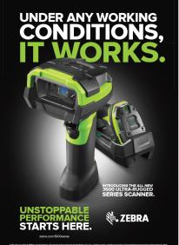
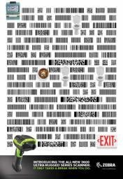
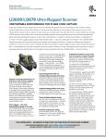
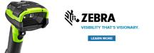
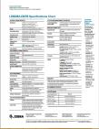

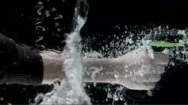
Sales Tools: Examples
Digital banner ad
Posters
Pop-up banner
Spec Sheets
Series Introduction Video
Digital video ad
76

Slide 77
Resources
Marketing - Reference Material on the Web
Partner Central: https://partnercentral.zebra.com 3600 Series Product Home: www.zebra.com/ultrarugged Enterprise Mobility Services: www.zebra.com/us/en/services.html Learning Portal: http://learning.zebra.com Solution Builder: https://solutionbuilder.zebra.com Co-branding Wizard: https://partnercentral.zebra.com Developer Tools: https://www.zebra.com/EnterpriseSupport App Gallery: http://appgallery.zebra.com
Software Developer - System Requirements
Developer Computers: Windows 7/64-bit, Mac Book Pro with at least 8 GB of memory. Android: Android Studio (1.0 or later), and Android API Level 19 or later. The recommended Android device version is KitKat 4.4.x. iOS: iOS SDK 7.0 or later; XCode version 6.0 or later. The recommended iOS version is 8.0 or later. Recommended devices: 5th and 6th generation iPod Touch and iPhone.
77

